Slide 1
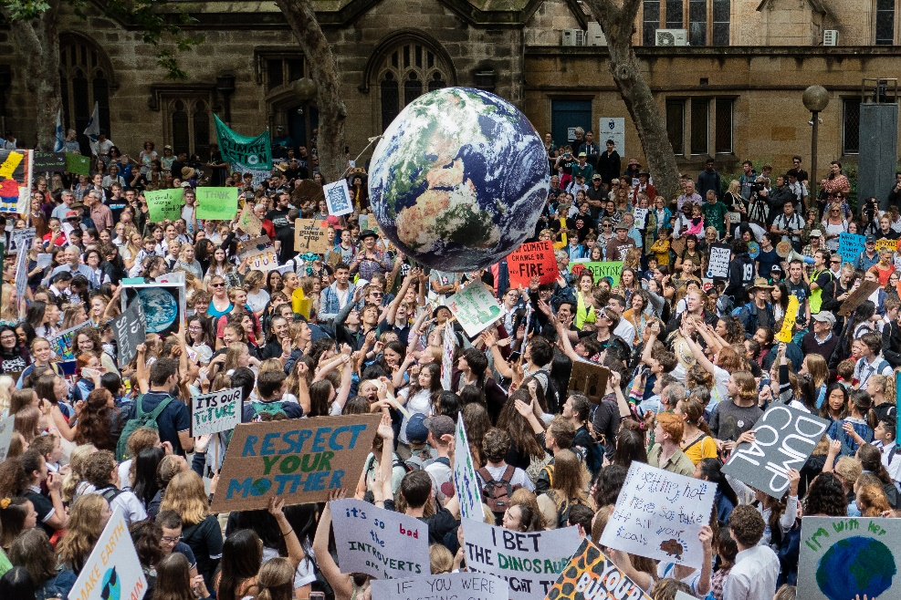
Carbon neutral
For Students

Slide 2
In compliance with

Slide 3
The challenge

Slide 4
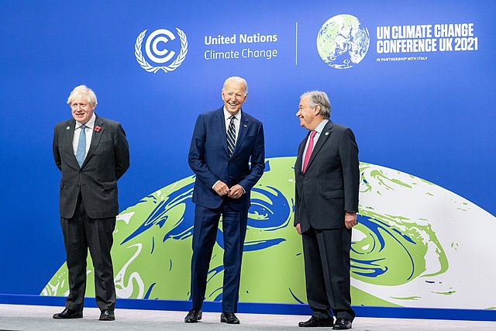
November 2021
World leaders gathered in Glasgow for a climate change conference.

Slide 5
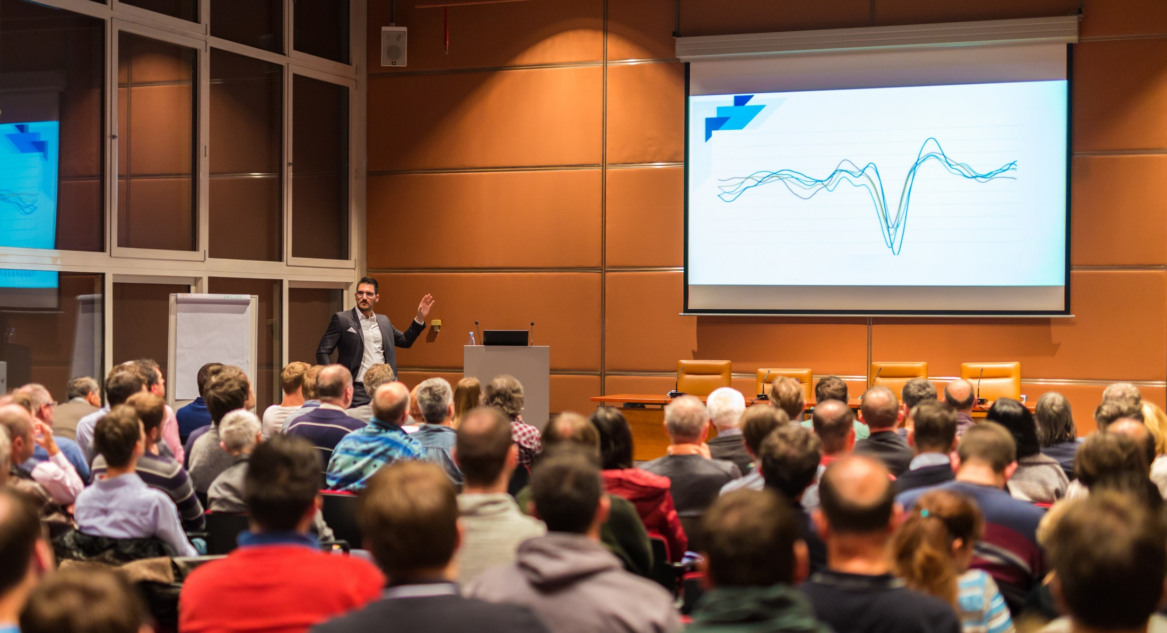
November 2023
Another conference – this time in the UAE.

Slide 6
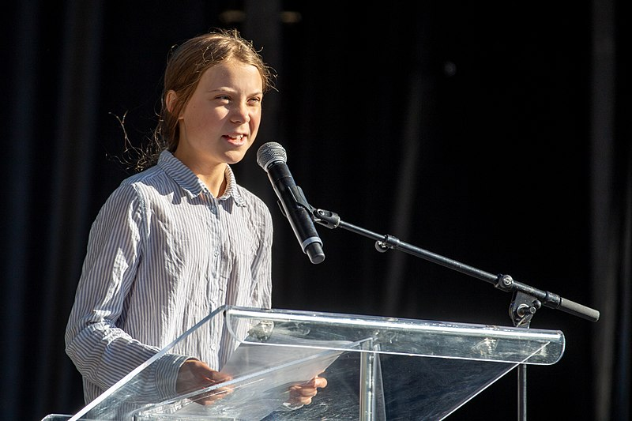
Or will the promises they make still all be
Click for video
This time will anything actually change?
BLAH
BLAH
?
BLAH

Slide 7
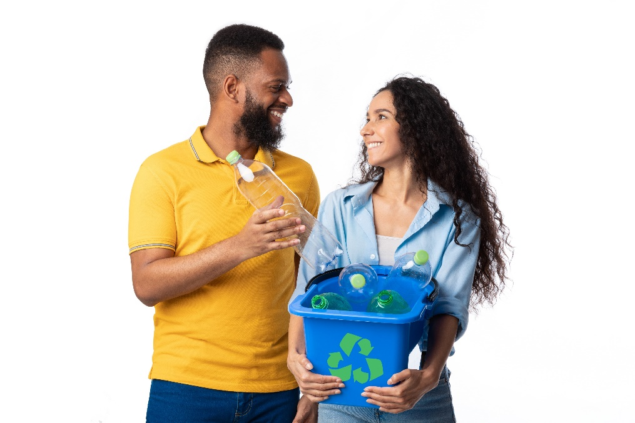
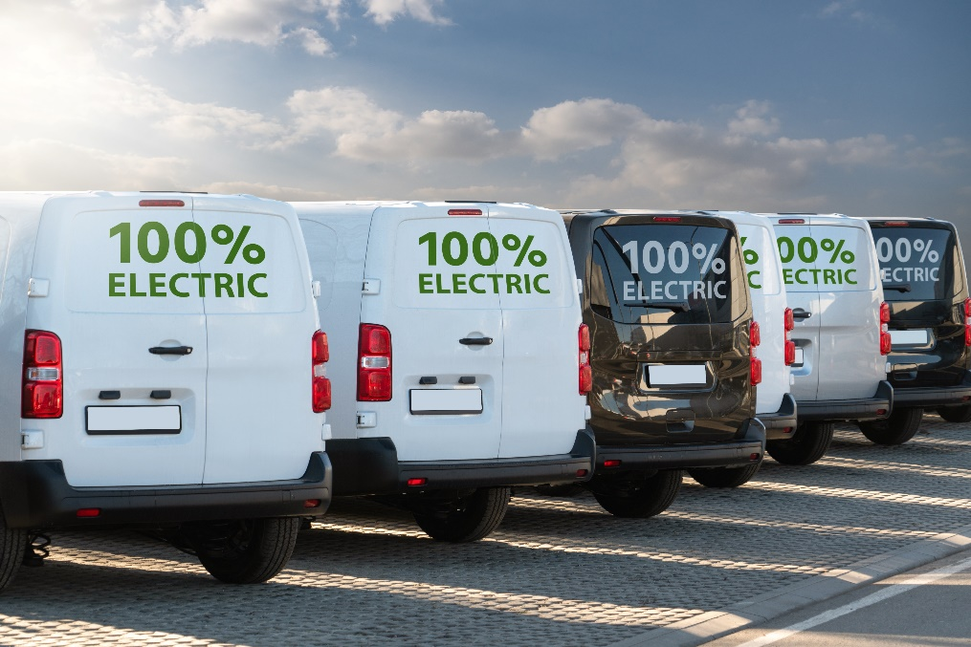
The government has pledged that the UK will be carbon neutral by 2050.
Both households and companies have to play their part.
How will it be more than ‘blah, blah, blah’?
What does carbon neutral mean?

Slide 8
Being carbon neutral means balancing the amount of carbon dioxide we release into the atmosphere with the amount we take out.
Amount of
CO₂ released =
Amount of
CO₂ taken out
How are we going to achieve being carbon neutral?

Slide 9
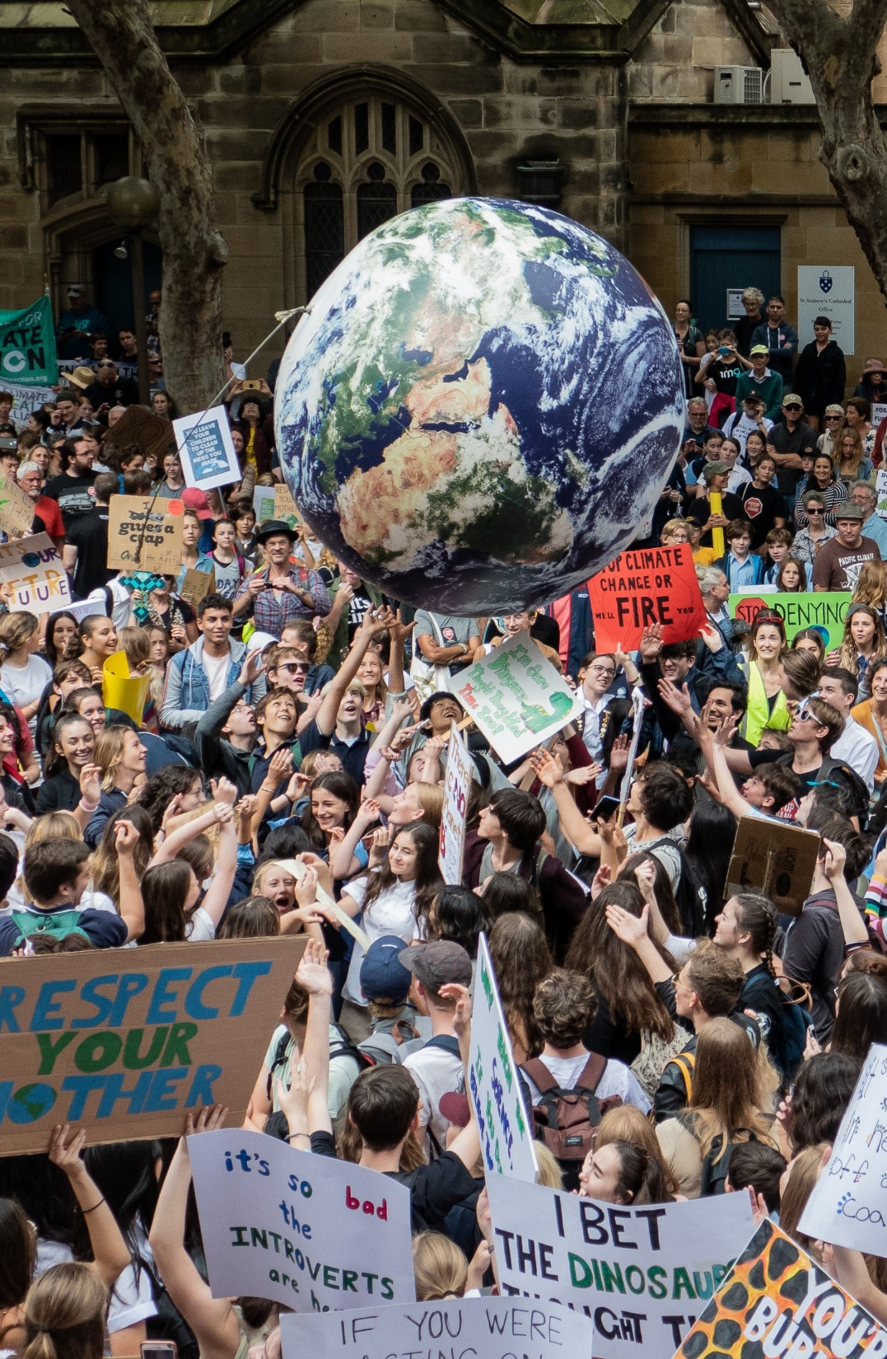
Young people are telling local companies to reduce how much CO₂ they release. This is called their carbon footprint. You could do this too.
First, learn how to make a persuasive case.
Let’s practise by helping a café become carbon neutral.

Slide 10
Welcome to my café - Coffee Club!
We buy environmentally-friendly coffee. But our carbon footprint is still 15 tons of CO₂ a year.
How do we become carbon neutral, without spending lots of money?
Please help!

