Slide 1
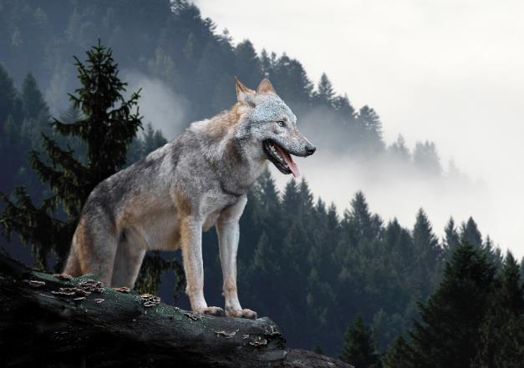
Rewilding
For Students

Slide 2
In compliance with

Slide 3
The challenge

Slide 4
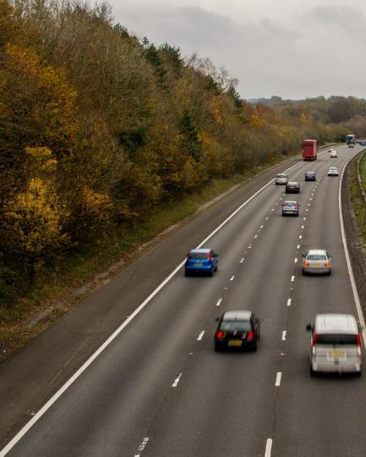
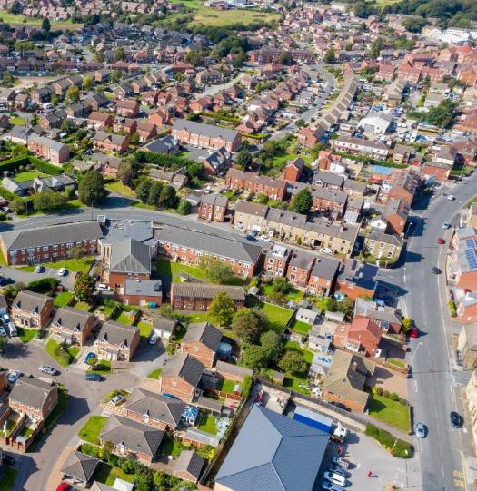
Britain today

Slide 5
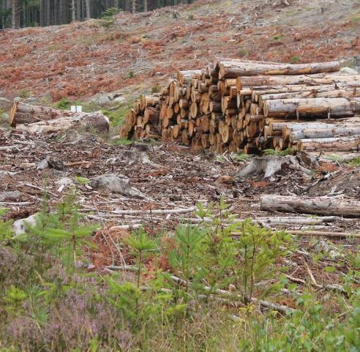
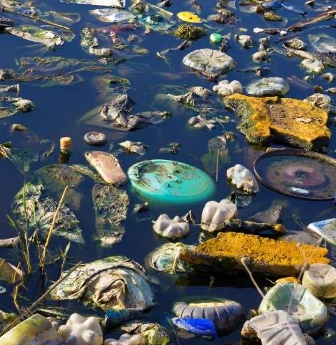
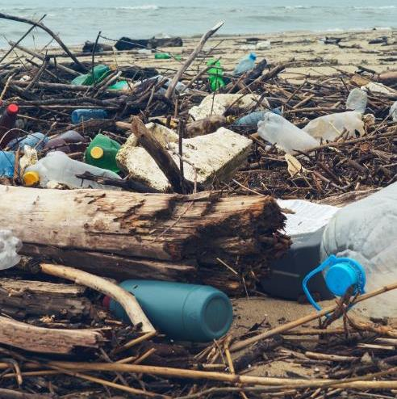
We’ve destroyed natural habitats that provide us with clean air and water,

Slide 6
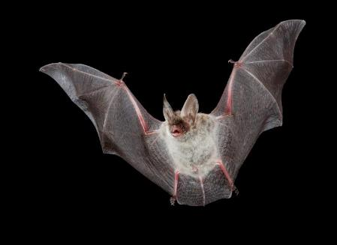
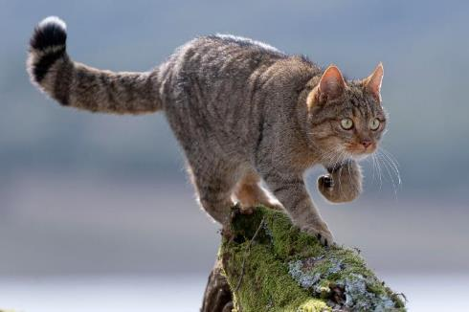
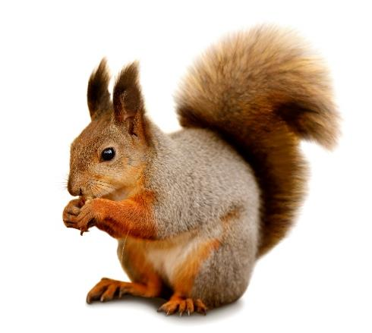
endangered native animals

Slide 7
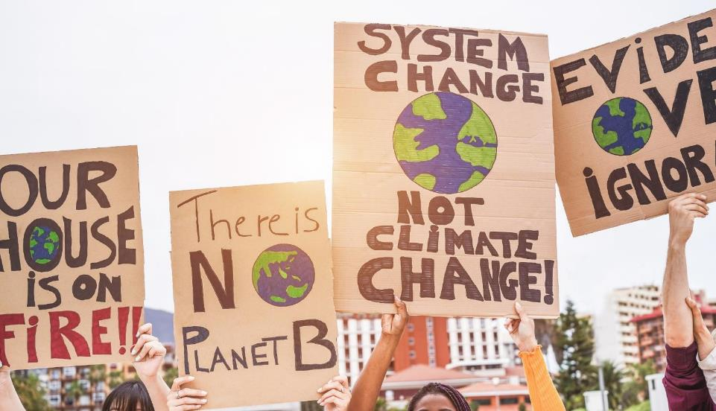
and are at the brink of a climate disaster

Slide 8
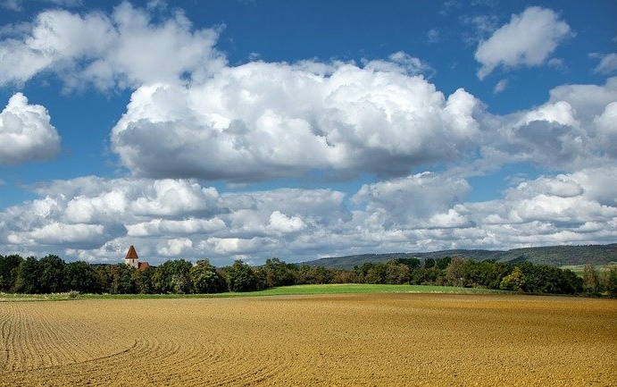
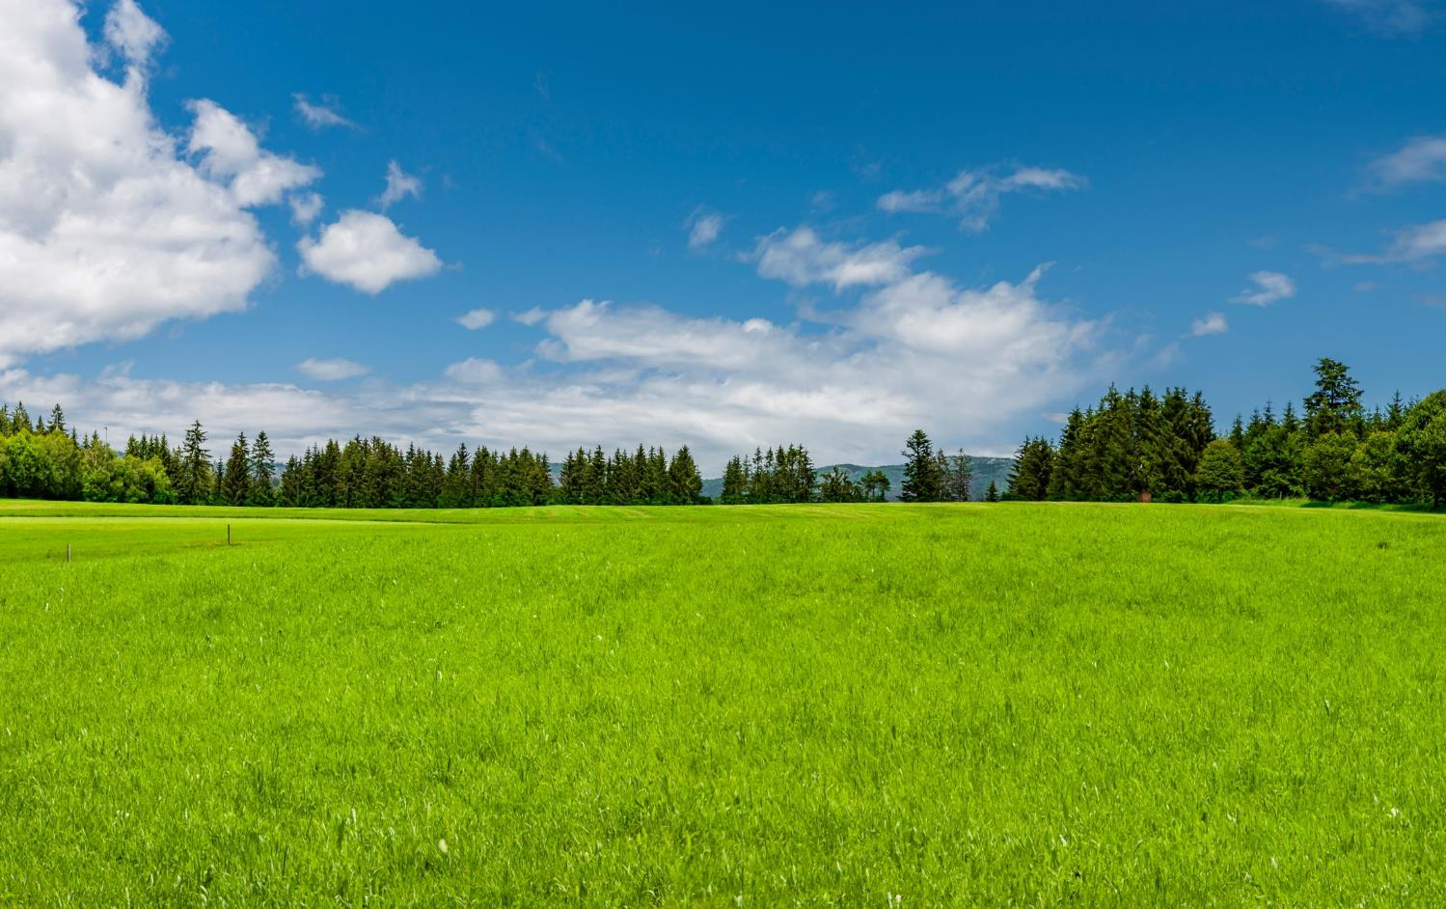
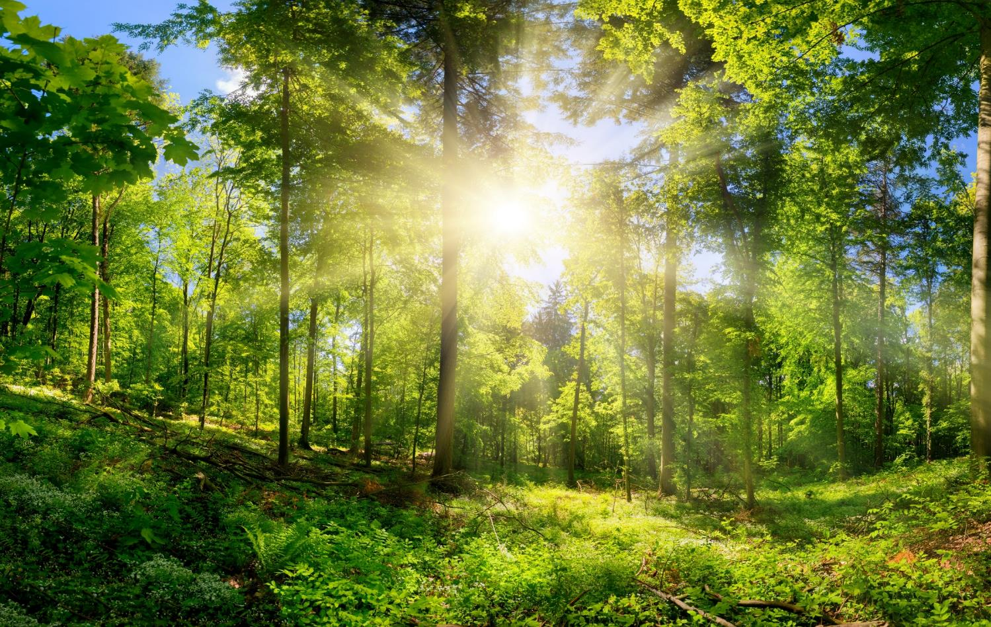
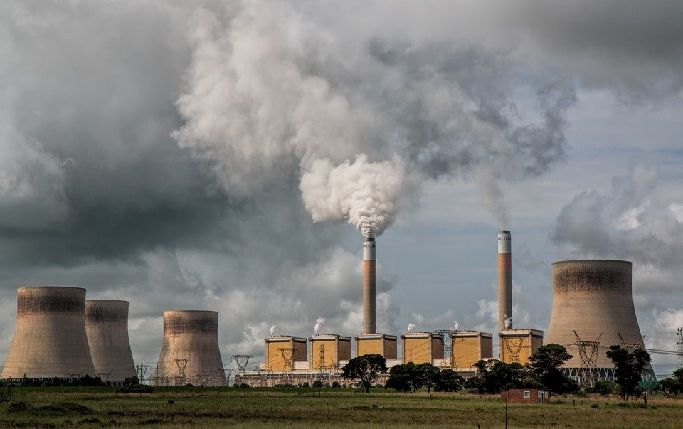
But it’s not too late.
Let’s heal the habitats we destroyed

Slide 9
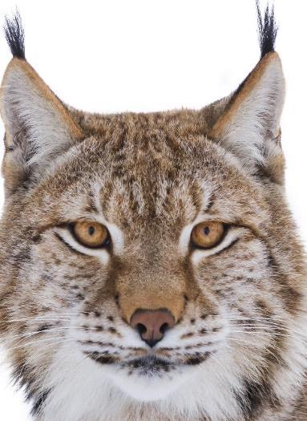
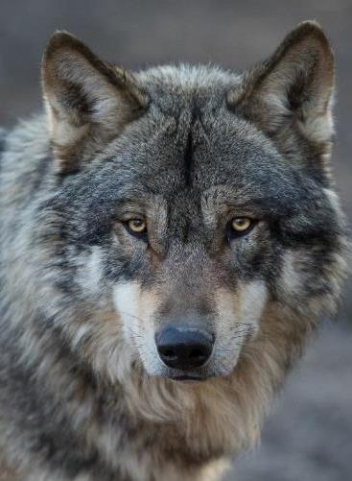
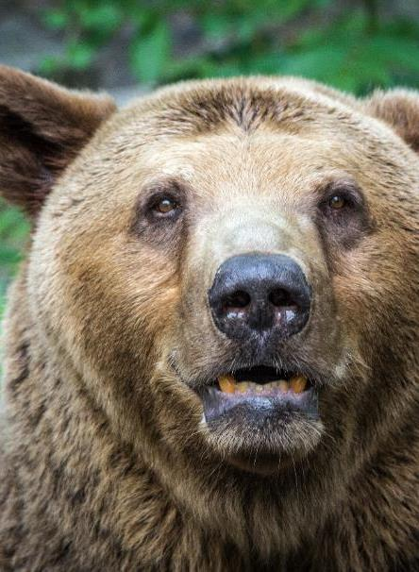
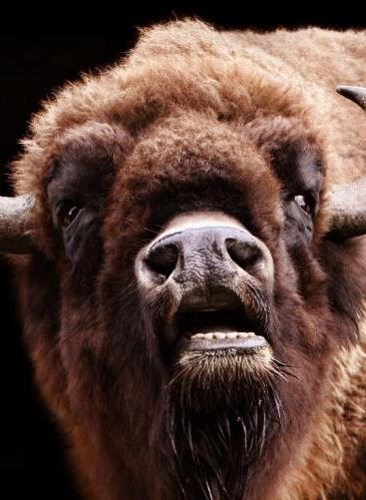
and reintroduce the lost animals to our forests

Slide 10
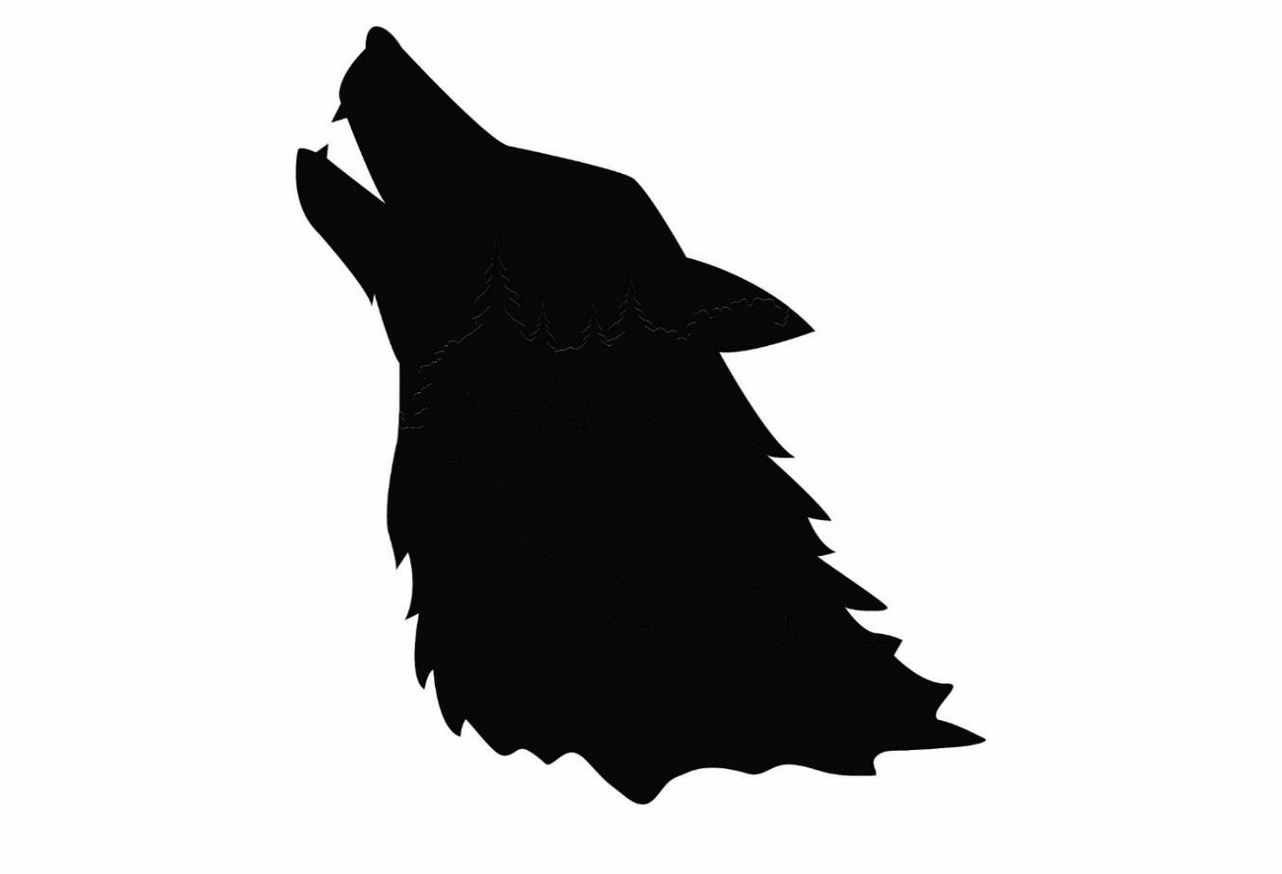
IT’S TIME TO…

Slide 11
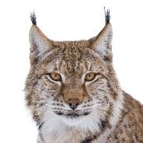
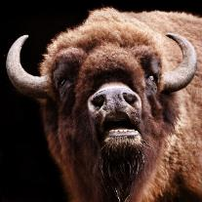
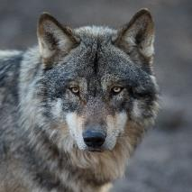
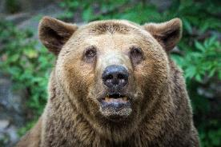
Let's meet our hopeful returners

Slide 12
Last seen in Britain 6000 years ago.
The gentle giant.
Introducing BISON!

Slide 13
Fighting for their return to the top of the forest food chain.
The clever predator.
It's WOLF!

Slide 14
Hunted to extinction but now hoping to return.
The shy feline.
It's LYNX!

Slide 15
And finally, the largest predator native to Britain.
The not-so-cuddly
BEAR!

Slide 16
Who do YOU want to see return?
Can you persuade others this is a good idea?

