Slide 1
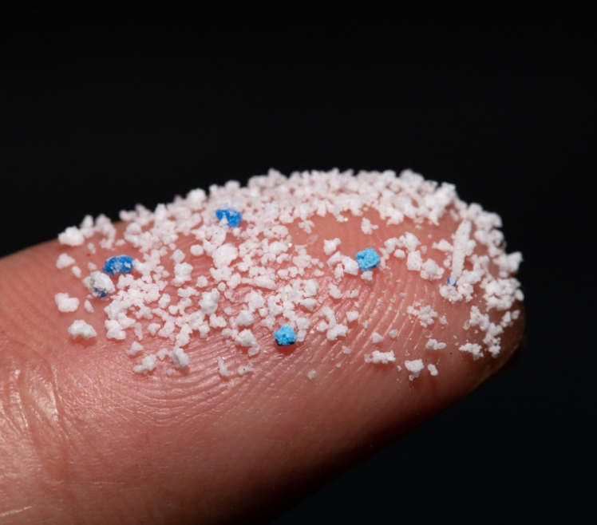
Microplastics
For Students

Slide 2
Contents
SS1: Size and scale
SS2: Competition entry

Slide 3
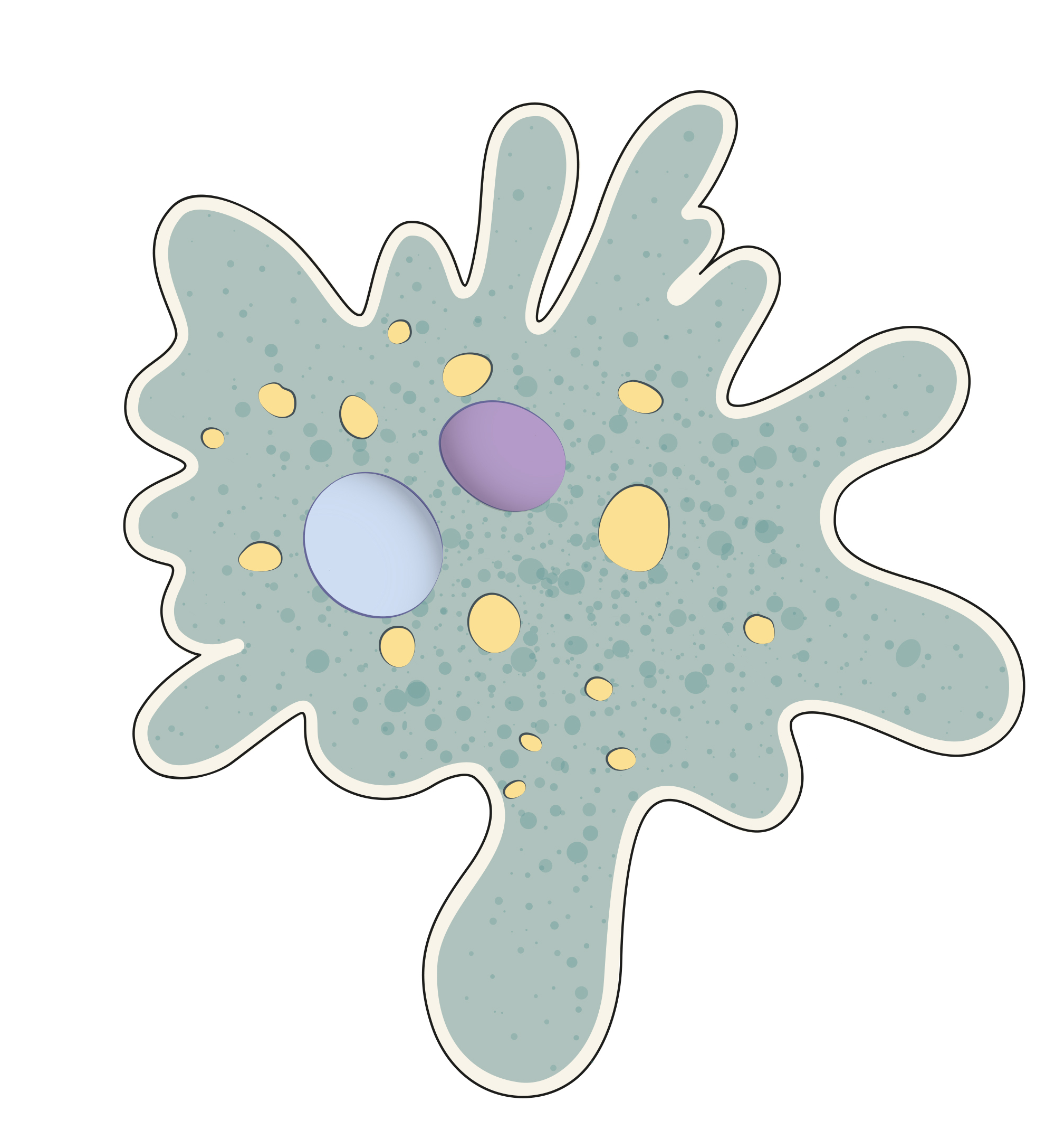
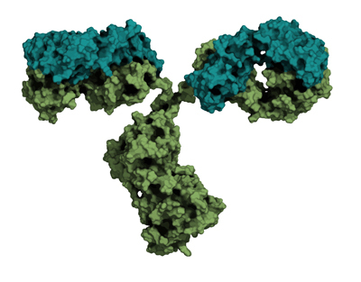
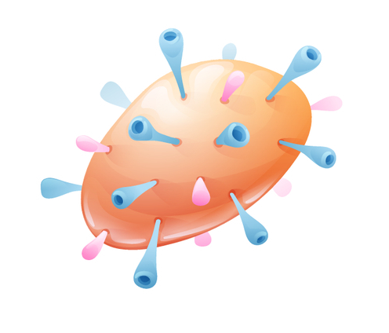
Size and scale
SS1
What to do:
1. Discuss what this diagram shows with a partner:
smallest microplastics
1 µm
medium sized microplastics
100 µm
largest microplastics
5 mm
water molecule
275 pm
antibody
12 nm
skin cell
30 µm
amoeba
500 µm
grain of rice
8 mm
measles virus
220 nm
mitochondrion
4 µm
Can see using a microscope
Can see just using your eyes
100 pm
1 nm
10 nm
100 nm
1 µm
10 µm
100 µm
1 mm
1 cm
pm is short for for picometre
1 pm = 0.001 nm
nm is short for nanometre
1 nm = 0.001 µm
µm is short for micrometre
1 µm = 0.001 mm
Each unit is 10 times (10x) bigger than the previous unit
2. Answer these questions on your own:
Put these objects in order of size, smallest first: bacteria, amoeba, antibody, skin cell.
If you lined up bacteria end-to-end, how many would fit inside a skin cell?
How big is an amoeba in mm?
True or false: The smallest microplastics are 0.001 mm.
Noah says ‘you can see if there are microplastics in water with your eyes.’ Do you agree? Give a reason for your answer.

Slide 4
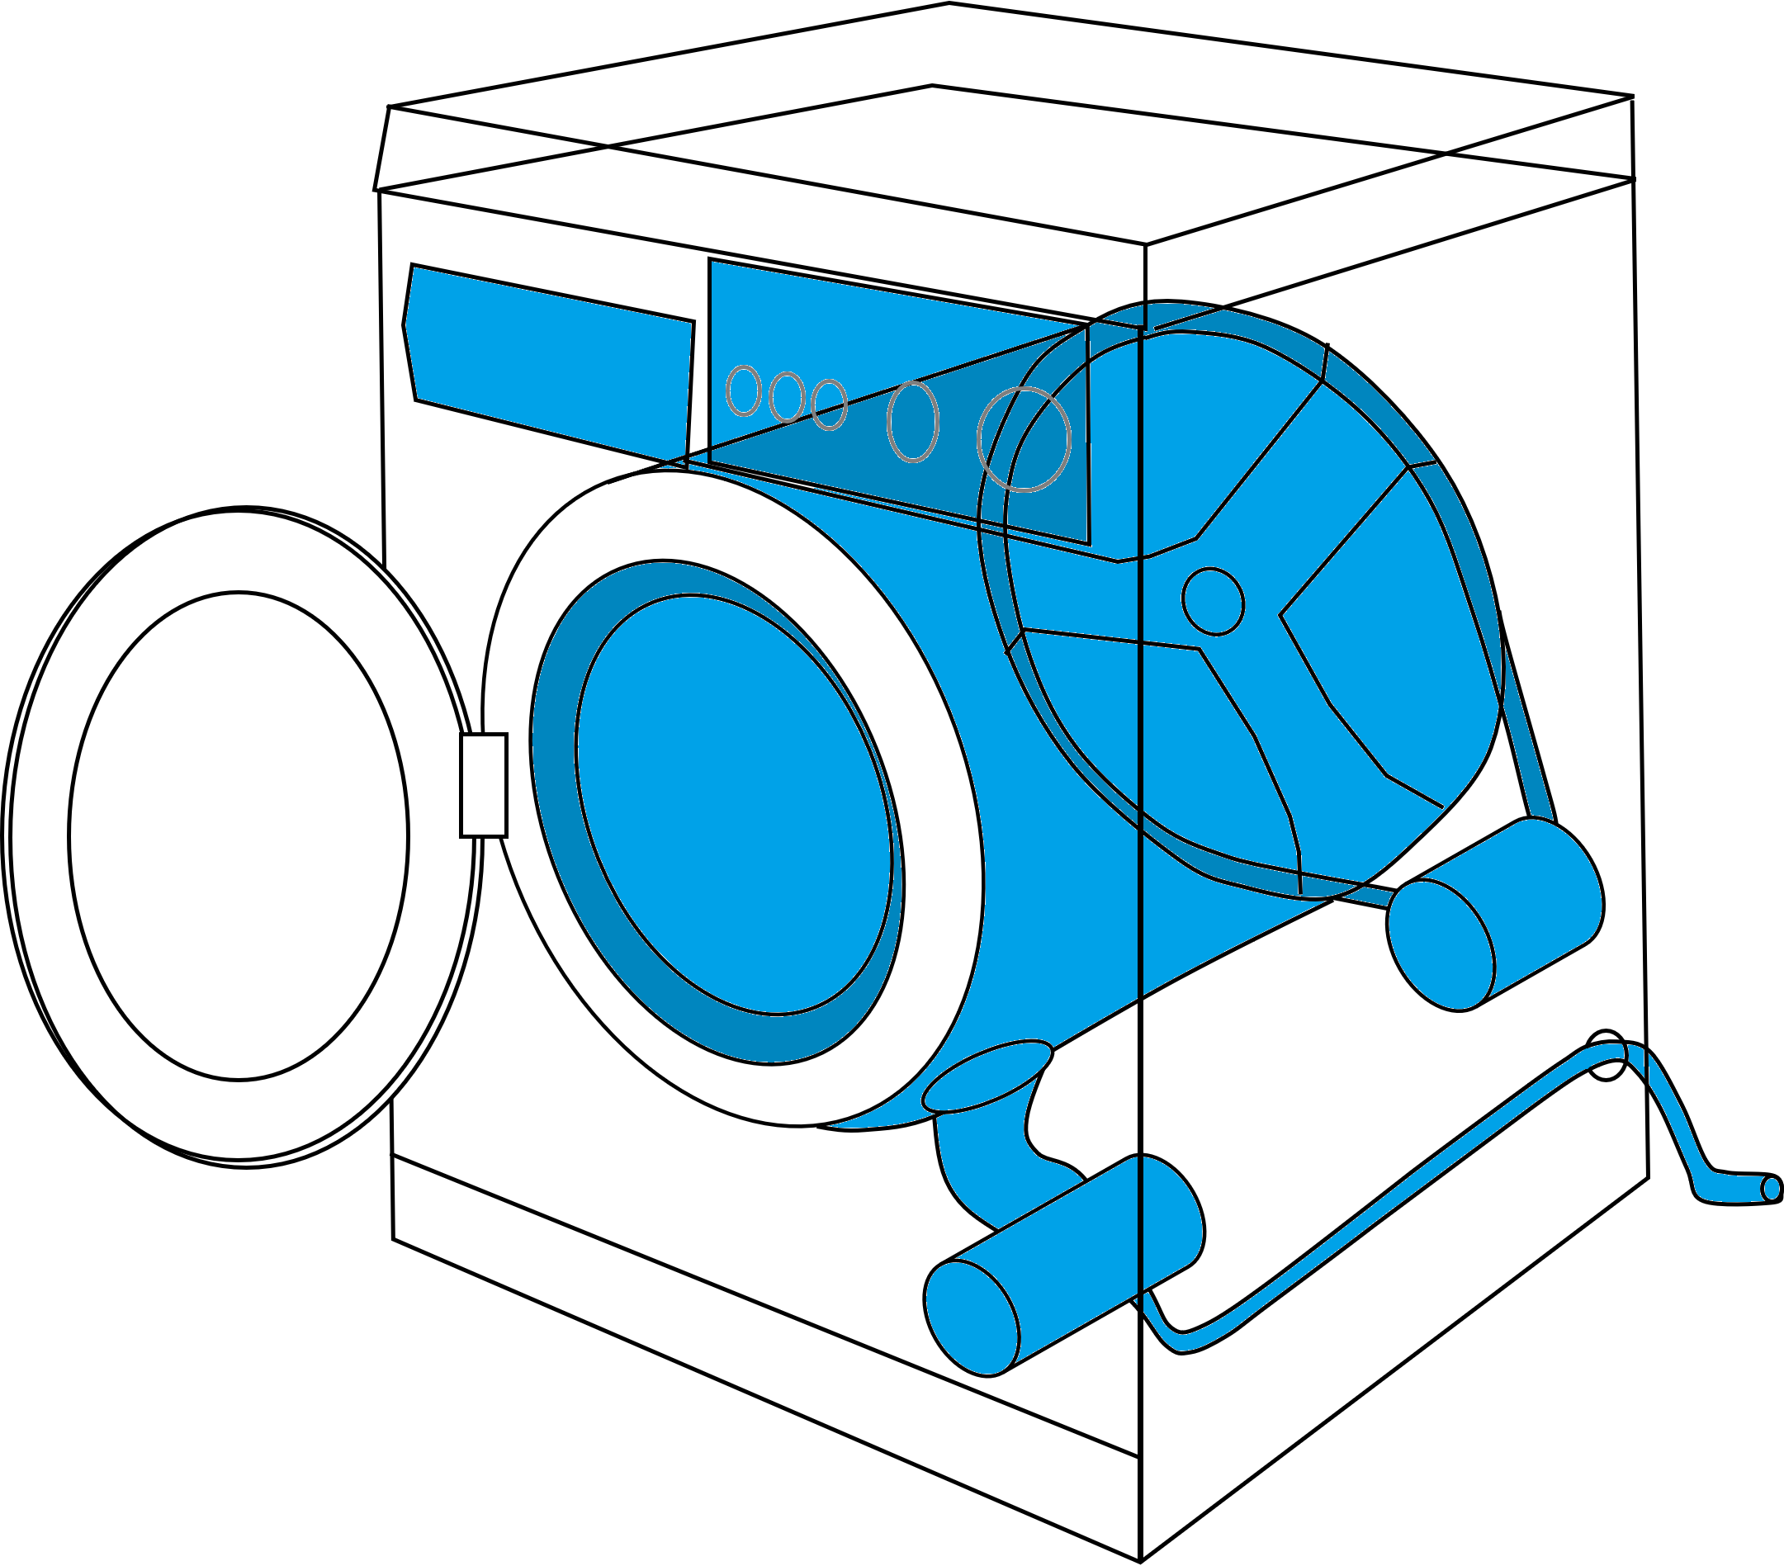
Competition entry
SS2
THE MICROPLASTIC CHALLENGE
Introduce your invention in a sentence: What is it and what job does it do?
Should the filter be paper or plastic?
What size should the holes be?
Draw your invention.
3. Explain how your invention works.
2. Describe your invention in detail.
Include a diagram to show how it filters out the microplastics.
Finish this diagram to show where to fit the filter
How does it stop microplastics getting into the sea?
4. Give reasons why your invention should win.
Clothes go in the drum. It then fills with water.
After the clothes are washed, the water leaves this way.
The water eventually ends up in the ocean.
Notes:
The answer should include the following:
Design of filter: made of plastic because paper would break down in the water
Holes need to be smaller than smallest microplastic (1 um).
Placement of filter: In a place that water containing microplastics flows through. If it is outside the machine, it is easier to empty.
How it works: Water and dissolved substances are small enough to pass through the holes in the filter, but microplastics are too large so stay in the filter.
The filter would have to be emptied now and then to remove the microplastics. A good place to put them would be in the rubbish bin, so they would be less likely to enter the water supply.

