Slide 1
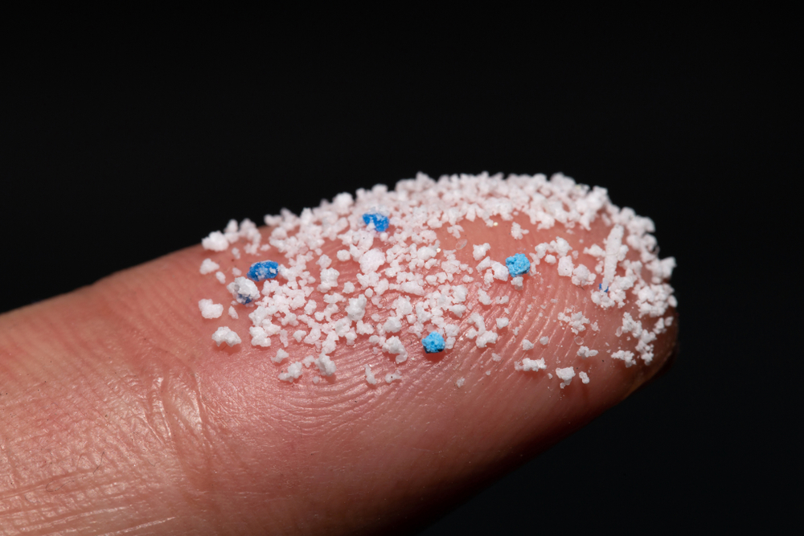
Microplastics
Draft slides
For Students

Slide 2
In compliance with

Slide 3
The challenge

Slide 4
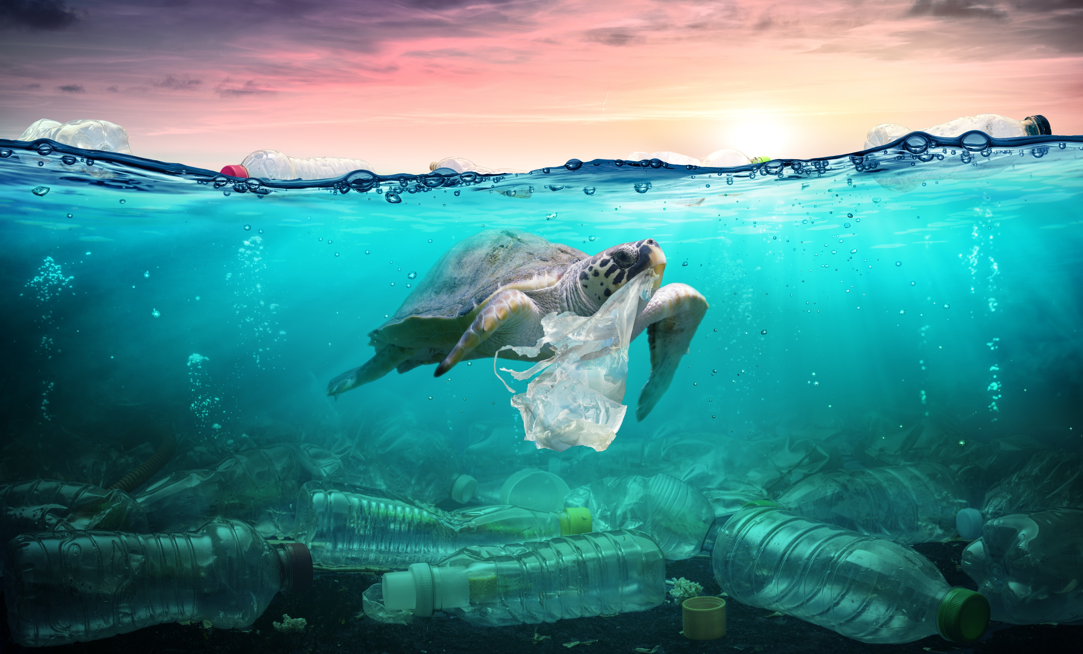
Plastic waste is killing our oceans.
If we don’t act now, by 2050 there could be more plastic than fish.

Slide 5
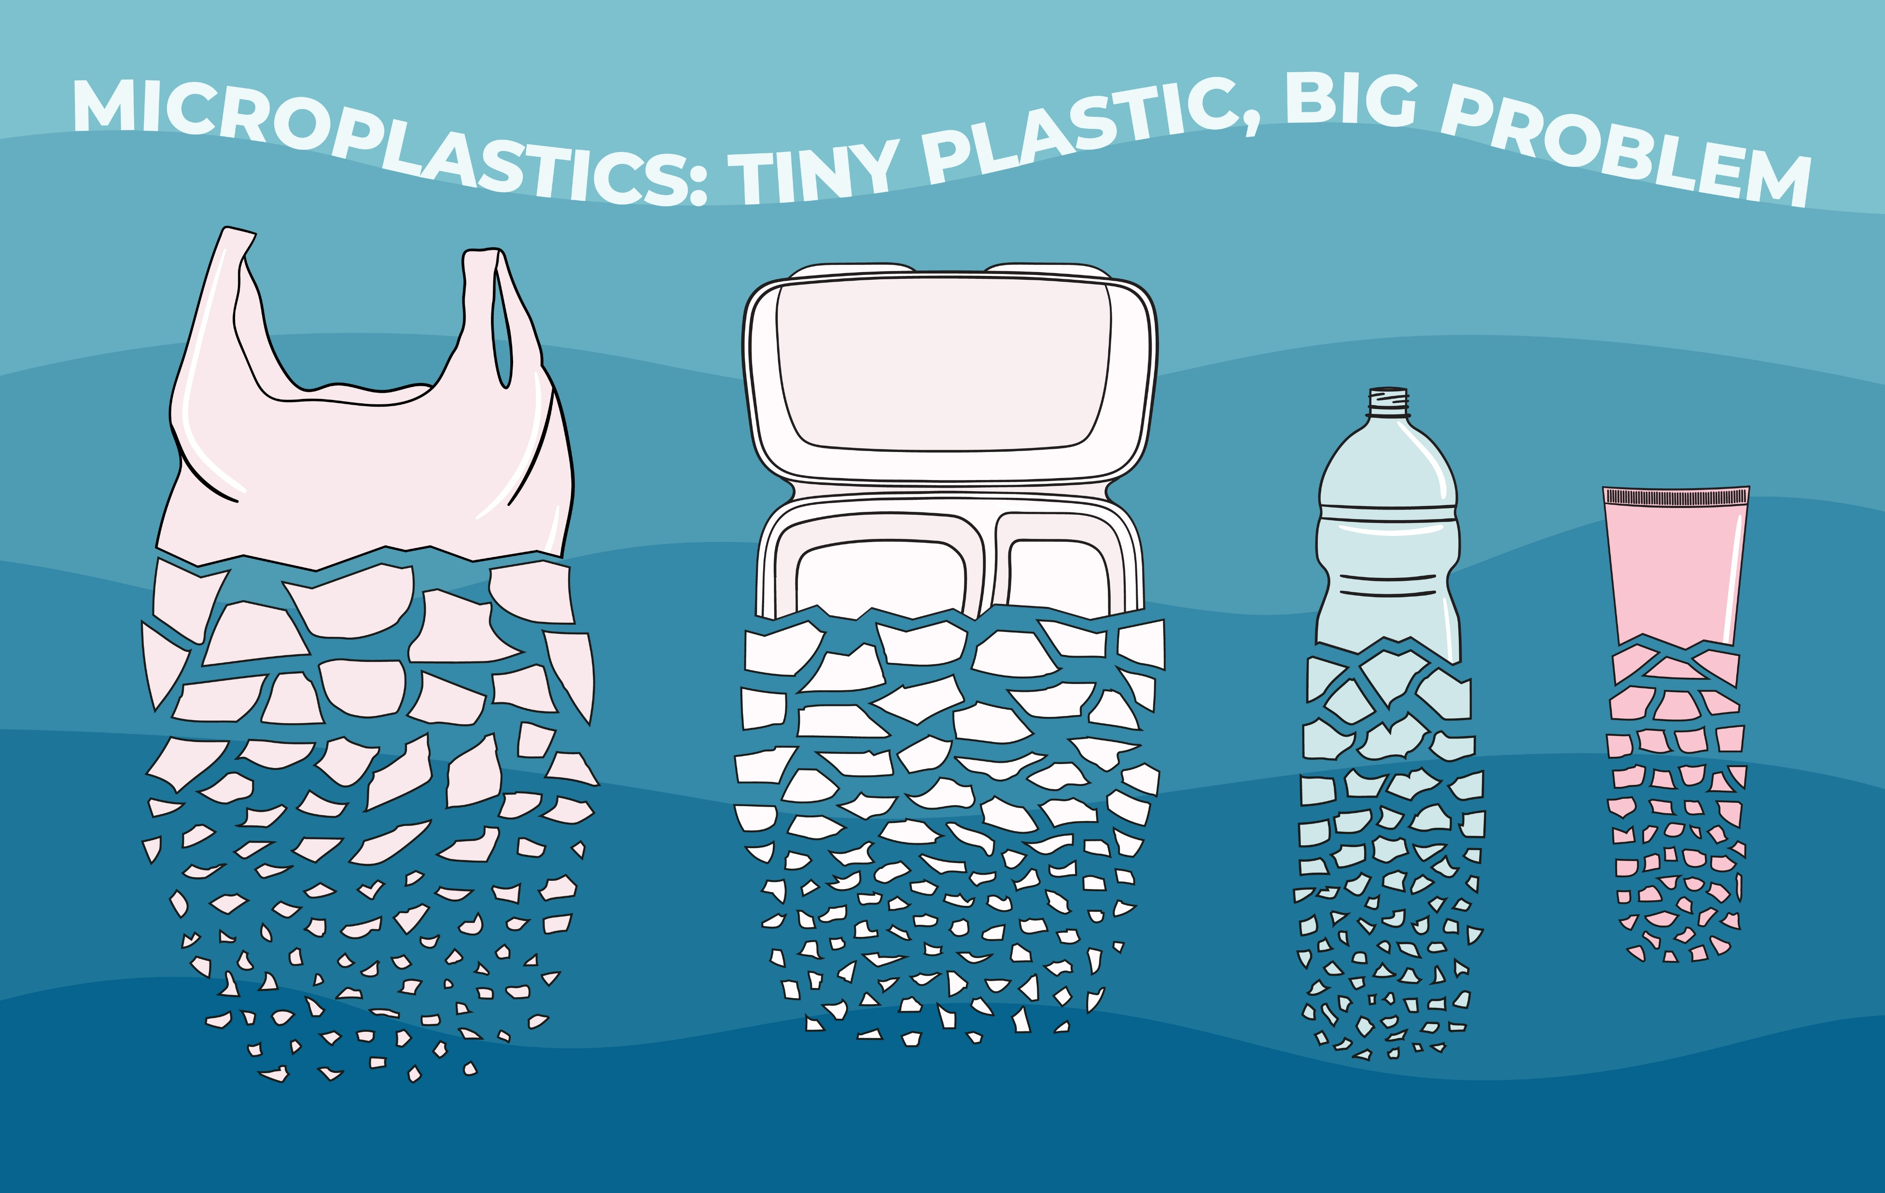
But it’s not just the plastic we can see.
Plastic breaks down into tiny bits – microplastics – that could be an even bigger problem.
Click for video

Slide 6
Microplastics get eaten by fish…
…and then by us.
Why might your body contain microplastics?
Notes:
Change to just plastics being eaten by animals

Slide 7
I want to find a way to help with the plastic problem.
Your engineer friend

Slide 8
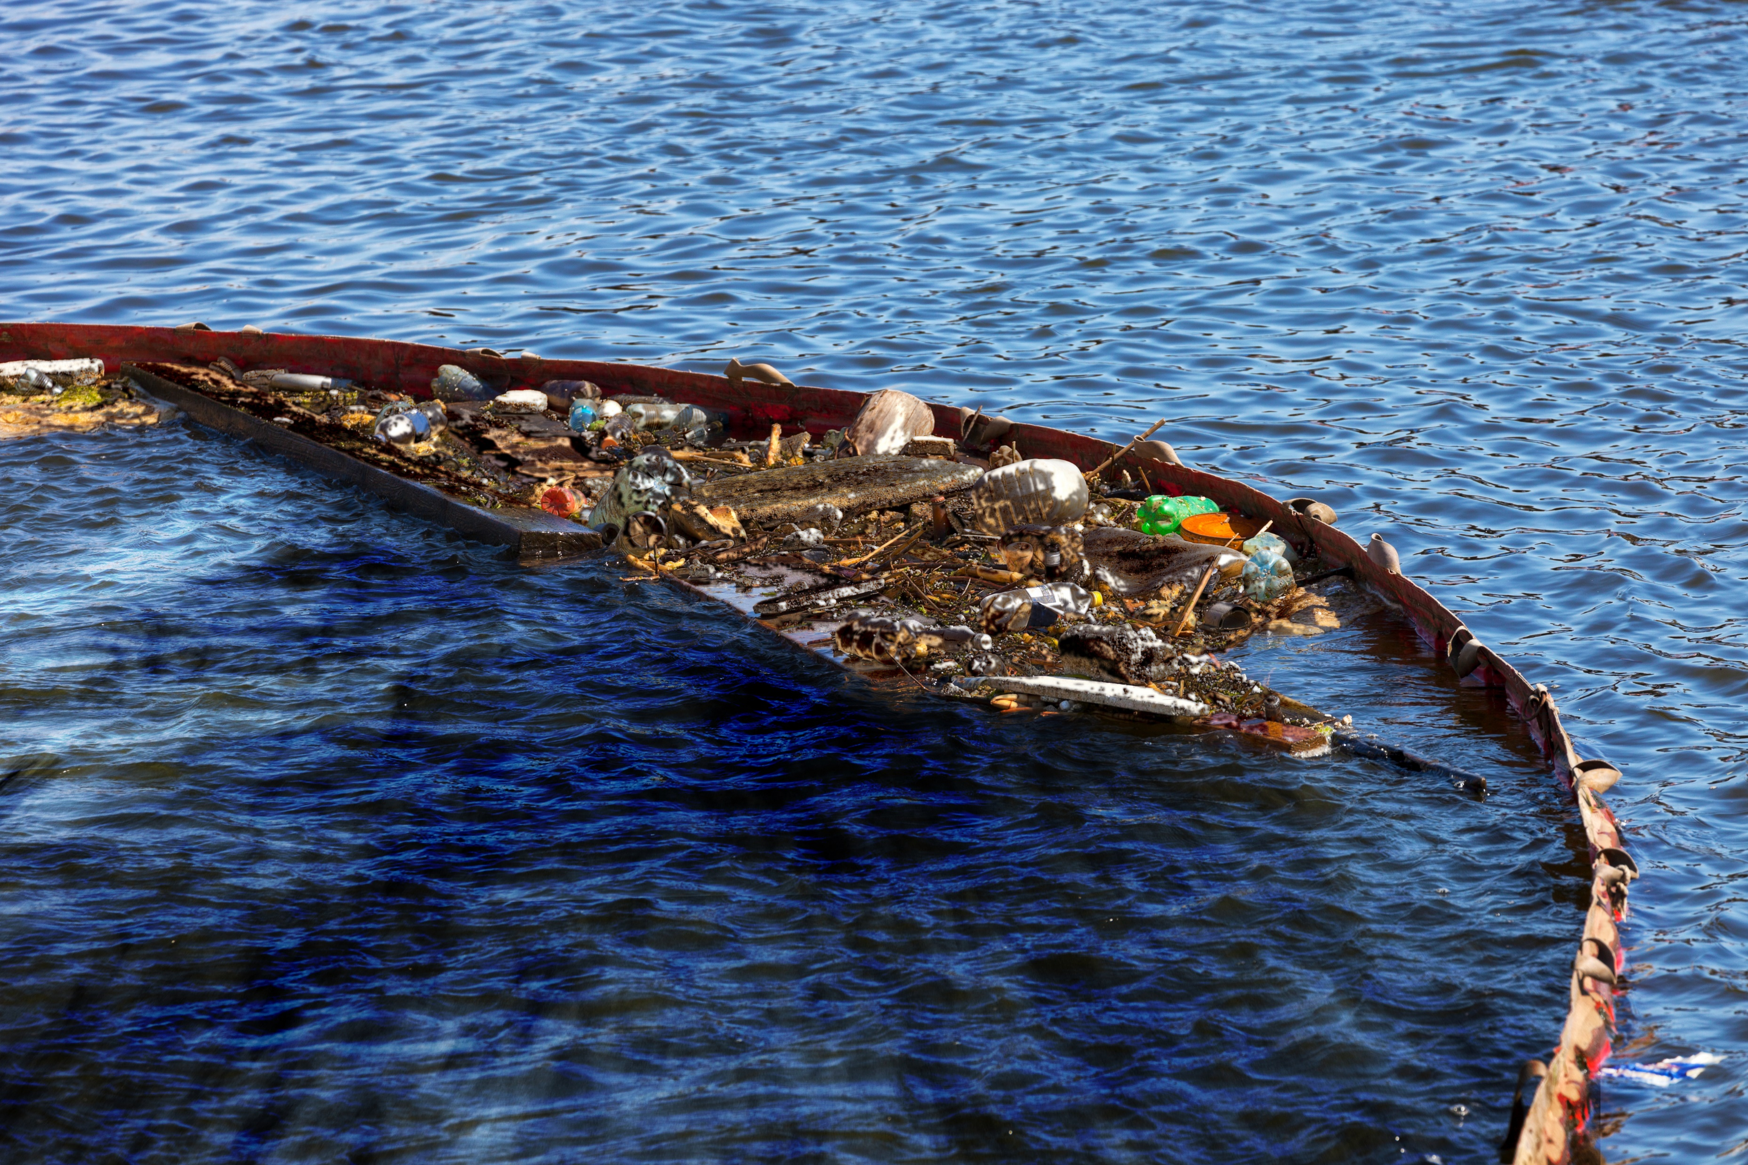
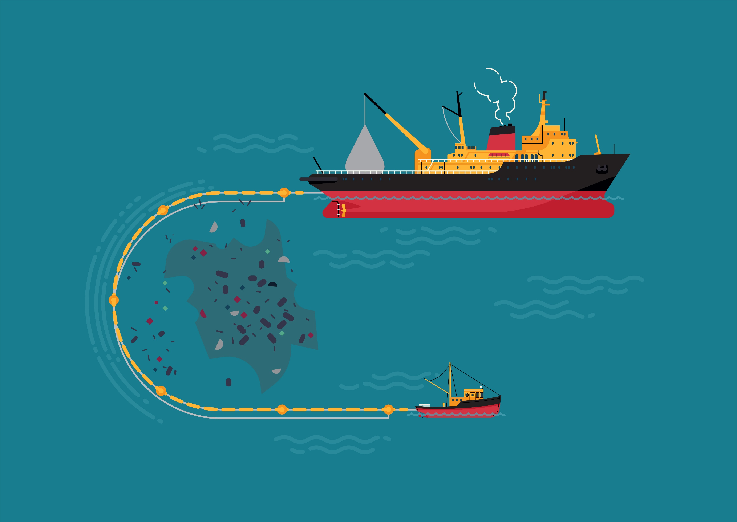
We’ve invented a way of removing large pieces of plastic from the oceans, but it doesn’t work for microplastics.
Why doesn’t this method remove microplastics?

Slide 9
THE MICROPLASTIC CHALLENGE
Let’s enter this competition.
Calling designers, engineers and scientists.
Can you invent a way to stop microplastics polluting our oceans?
The winner will get funding to develop their idea.
Enter your invention
Notes:
Add engineer again to the side – there is this great challenge – let’s enter it.

Slide 10
Of course, the best way to stop microplastic pollution is to stop throwing away plastic.
But I’m not sure this is possible – what do you think?
Home task
Find out if you could live plastic-free
Notes:
Remove if you have a scientist

