Slide 1
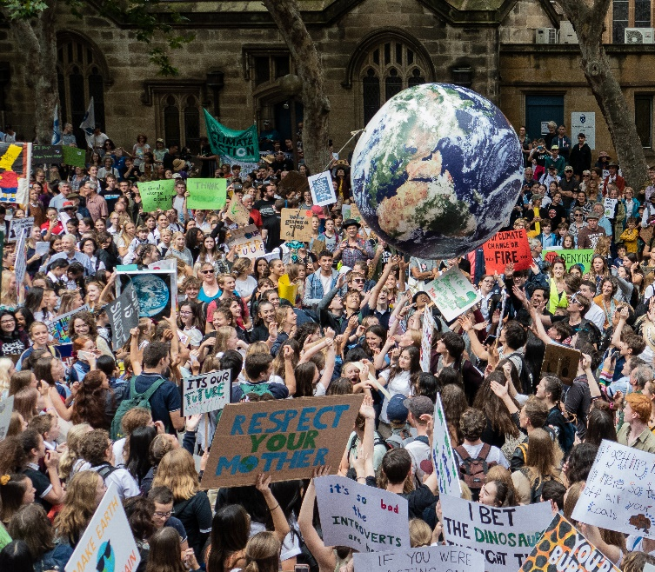
Carbon neutral
For Students

Slide 2
KNOW 1: Carbon

Slide 3
Index
SS1: Transport (staff)
SS2: Transport (goods)
SS3: Electricity
SS4: Waste
SS5: Assessment rubric

Slide 4
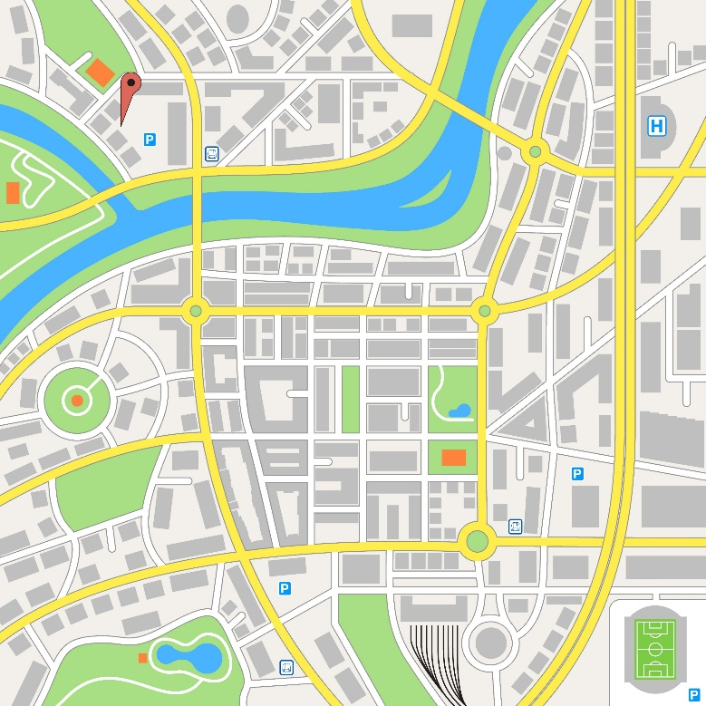
Transport (staff)
SS1
The staff have to travel to the café. They use different types of transport. The map shows the location of the café.
Discuss:
Why does transport produce CO₂ emissions?
Which person’s transport produces most CO₂? Why?
Town map
Staff
Name | Rose | Billy | Ren | Maria | Femi
Position | Owner | Assistant manager | Supervisor | Barista | Barista
Hours per week | 40 | 35 | 20 | 12 | 6
How far they live from the café | 7.5 km | 6 km | 5 km | 10 km | 1.5 km
How they get to work | Train | Drive (petrol car) | Bus | Drive (petrol car) | Walk
Café
Train station
Bus stop
100 m

Slide 5
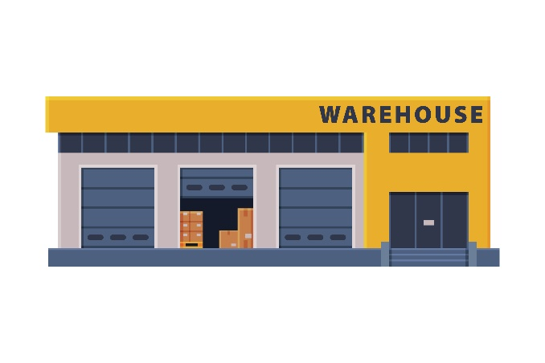
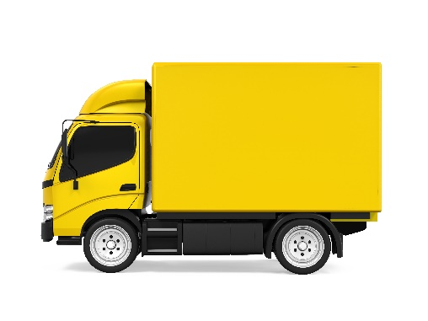
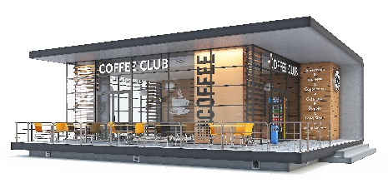
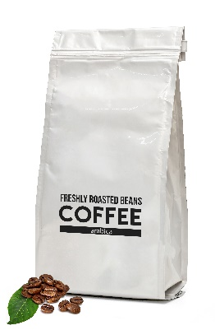
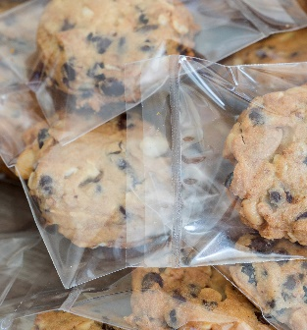
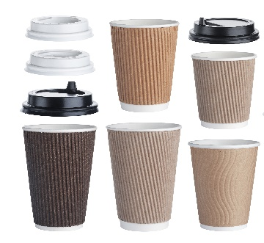
Transport (goods)
SS2
Goods for the café are delivered from a wholesaler who is 10 km away.
Goods are delivered once per week by lorry.
Discuss:
Why does transporting goods produce CO₂ emissions?
Which good produces most CO₂ emissions when it’s transported? Why?
Goods delivered every week
Coffee beans from Brazil
(9000 km away)
Milk from farms across the UK
(20 – 400 km away)
Pre packaged cakes and biscuits from UK factory
(260 km away)
Cane sugar from Belize
(8000 km away)
Cups and lids from a UK manufacturer
(108 km away)

Slide 6
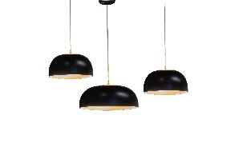
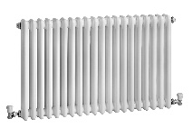
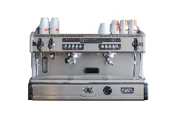
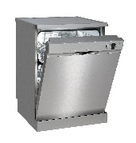
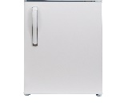
Electricity
SS3
The café buys its electricity from a supplier. They buy electricity from all the different power stations in the country. These include nuclear, biomass and fossil fuel power plants, wind farms and solar panels.
Discuss:
Why do electrical appliances produce CO₂ emissions?
Which appliance produces most CO₂ emissions? Why?
Unit (kWh) =
Power (kW) x time (hour)
Each units costs 15p
Appliance | Power in kW | Time it is used for (average per month in hours) | Average number of units used per month | Cost to run per month
Lighting | 1.6 | 240 | 384 | £57.60
Heating | 2.5 | 100 | 250 | £37.50
Coffee machine | 3.8 | 180 | 684 | £102.60
Dishwasher | 1.8 | 90 | 162 | £24.30
Fridge | 0.2 | 720 | 144 | £21.60

Slide 7
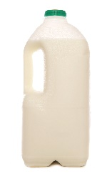
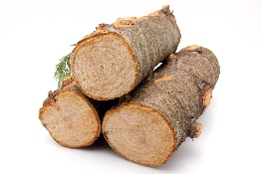
Waste
SS4
The paper cups and empty milk cartons are recyclable. The cafe has recycling bins. Most waste is sent to landfill or burnt in an incinerator. Customers also take used cups out of the the building and throw them away.
Discuss:
Why does waste produce CO₂ emissions?
Which waste from the café produces most CO₂ emissions? Why?
Waste per week
Five empty plastic bags
50 plastic bottles
300 plastic wrappers
750 paper wrappers
1000 paper cups and plastic lids
Recycling (lower carbon footprint)
Making new product from raw materials (higher carbon footprint)
Product
10 kg of coffee grounds
Raw material (wood)
Product
Paper pulp

Slide 8
Assessment rubric
SS5
Score | Level | Description | Example of a typical student response for one part of the answer
1 | No link | Relevant ideas | “Two of the staff drive cars, and these release carbon dioxide.”
2 | Partial link | Relevant ideas with simple connections | “Two of the staff drive petrol cars to get to the café. Inside the engine, petrol is burnt which releases carbon dioxide.”
3 | Full link | At least two ideas logically connected. Use of some scientific language. | “Two of the staff drive petrol cars to get to the café. Inside the engine, petrol is burnt which is a combustion reaction. Carbon dioxide is one of the products of this reaction. Other forms of transport the staff use incudes buses and trains, which also release carbon dioxide.”
4 | Extended link | Several ideas connected with scientific reasoning. May link to other concepts. Use of accurate scientific language. | “Two of the staff drive petrol cars to get to the café. Inside the engine, petrol is burnt which is a combustion reaction. Carbon atoms in the petrol molecules are oxidised to produce carbon dioxide. Other forms of transport the staff use incudes buses and trains, which also release carbon dioxide. However, as they are sharing the transport with many others the amount of CO₂ emitted per person is lower than if you drive a car alone. One staff member walks. This is the only form of transport that does not release carbon dioxide.”

Slide 9
KNOW 2: Game

Slide 10
Index
SS1: Game cards
SS2: Game rules
SS3: Game of consequences board
SS4: Problem: Transport
SS5: Problem: Electricity
SS6: Problem: Waste

Slide 11
Game cards
SS1

Slide 12
Game rules
SS2
You will need:
A game of consequences board
Blank cards cut up
A consequence is an action that has an effect that can be negative or positive
Red and green pen/pencil
3 players
Instructions
1 Write the action on the large card and place in the centre of the board.
2 Place the other cards in a pile.
3 The first player thinks of one consequence of the action and shares it with the other players. If they agree that it is a consequence then the player takes a small card from the pile and writes on the consequence along with their initials. This is placed on one of the boxes marked with a 1. Take it in turns so all the ‘1’ boxes are filled up.
4 Now, you must fill up the boxes marked with a 2 only. These are consequences of the suggestions in the ‘1’ boxes.
5 Continue until all the ‘2’ boxes are filled. Then move onto the ‘3’ boxes.
6 When all boxes are filled, go through each of the ‘2’ and ‘3’ boxes and decide if it is a negative or positive consequence (some might be both). Mark all the negative consequences with the red pen and positive with the green pen.
7 Then, count up how many consequences are negative and how many are positive.

Slide 13
Game of consequences board
SS3
3
2
2
3
1
3
3
Action
2
1
1
2
2
3
3
2

Slide 14
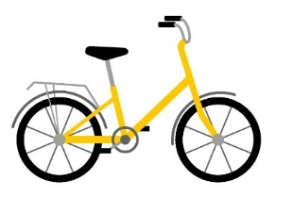
Problem: Transport
SS4
SS4
Transport releases carbon dioxide:
Staff travel to the café. Some use vehicles that burn petrol or diesel.
Café supplies are delivered in a lorry once a week from a wholesalers 10 km away.
Supplies come from around the world e.g. coffee from Brazil and milk from all around the UK.
Transport releases carbon dioxide:
Staff travel to the café. Some use vehicles that burn petrol or diesel.
Café supplies are delivered in a lorry once a week from a wholesalers 10 km away.
Supplies come from around the world e.g. coffee from Brazil and milk from all around the UK.
Action 1: Demand that all staff walk, cycle or use public transport to get to work.
Cost: £££
Carbon reduction:
Action 1: Demand that all staff walk, cycle or use public transport to get to work.
Cost: £££
Carbon reduction:
Action 2: Buy all staff a bike so they can cycle to work.
Cost: £££
Carbon reduction:
Action 2: Buy all staff a bike so they can cycle to work.
Cost: £££
Carbon reduction:
Action 3: Where possible, buy goods from local suppliers e.g. milk from a nearby farm. They may be more expensive but they don’t have to travel so far.
Cost: £££
Carbon reduction:
Action 3: Where possible, buy goods from local suppliers e.g. milk from a nearby farm. They may be more expensive but they don’t have to travel so far.
Cost: £££
Carbon reduction:

Slide 15
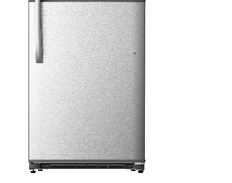
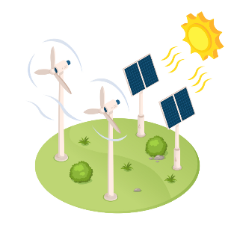
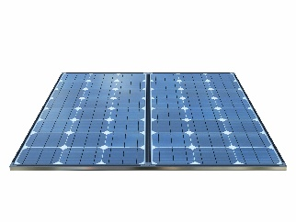
Problem: Electricity
SS5
Problem: Electricity
SS5
Using electricity releases carbon dioxide:
The café uses electricity for light and heat.
There are many electrical appliances – a coffee machine, dishwasher and fridge.
The café buys electricity from a supplier who uses fossil fuel power stations. Burning fossil fuels (coal, oil and gas) releases carbon dioxide.
Using electricity releases carbon dioxide:
The café uses electricity for light and heat.
There are many electrical appliances – a coffee machine, dishwasher and fridge.
The café buys electricity from a supplier who uses fossil fuel power stations. Burning fossil fuels (coal, oil and gas) releases carbon dioxide.
Action 1: Buy new appliances that are energy efficient. They are expensive to buy but use less electricity so will also save money in electricity bills.
Cost: £££
Carbon reduction:
Action 1: Buy new appliances that are energy efficient. They are expensive to buy but use less electricity so will also save money in electricity bills.
Cost: £££
Carbon reduction:
Action 2: Swap to a new electricity supplier that is more expensive per unit but only buys electricity from sources that release no CO₂ e.g. wind farms.
Cost: £££
Carbon reduction:
Action 2: Swap to a new electricity supplier that is more expensive per unit but only buys electricity from sources that release no CO₂ e.g. wind farms.
Cost: £££
Carbon reduction:
Action 3: Put solar panels on the roof. They are very expensive to buy, but it will mean the café can buy less electricity from a supplier, saving money in the long-term.
Cost: £££
Carbon reduction:
Action 3: Put solar panels on the roof. They are very expensive to buy, but it will mean the café can buy less electricity from a supplier, saving money in the long-term.
Cost: £££
Carbon reduction:

Slide 16
Problem: Waste
SS6
Problem: Waste
SS6
Waste releases carbon dioxide:
Rubbish put into bins ends up in landfills or is burnt in an incinerator.
In landfills, bacteria decay the rubbish and release carbon dioxide.
Burning rubbish releases carbon dioxide.
Waste releases carbon dioxide:
Rubbish put into bins ends up in landfills or is burnt in an incinerator.
In landfills, bacteria decay the rubbish and release carbon dioxide.
Burning rubbish releases carbon dioxide.
Action 1: Reduce packaging or use recyclable packaging (which is more expensive). Encourage customers to recycle their cups.
Cost: £££
Carbon reduction:
Action 1: Reduce packaging or use recyclable packaging (which is more expensive). Encourage customers to recycle their cups.
Cost: £££
Carbon reduction:
Action 2: Sell reusable cups with the café name on them, and give customers a 10% discount on their drink if they use one.
Cost: £££
Carbon reduction:
Action 2: Sell reusable cups with the café name on them, and give customers a 10% discount on their drink if they use one.
Cost: £££
Carbon reduction:
COFFEE
CLUB
COFFEE
CLUB
Action 3: Donate all left-over food to a homeless charity and used coffee grounds to the local allotments (it is great fertiliser).
Cost: £££
Carbon reduction:
Action 3: Donate all left-over food to a homeless charity and used coffee grounds to the local allotments (it is great fertiliser).
Cost: £££
Carbon reduction:

Slide 17
DO: Recommendations

Slide 18
Index
SS1: Offset your household’s footprint
SS2: Help Coffee Club become carbon neutral
SS3: Action costs and savings
SS4: Assessment checklist

Slide 19
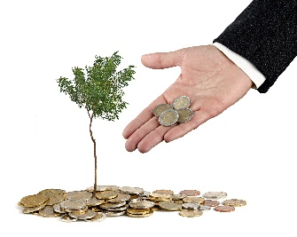
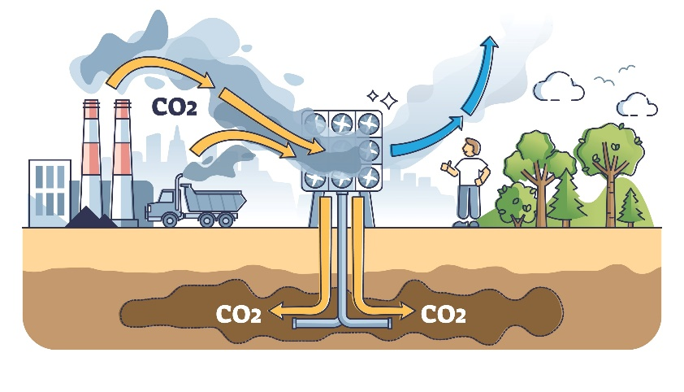
Offset your household’s footprint
SS1
You can reduce your carbon footprint but it’s impossible to reduce it to zero. So how do households and businesses become carbon neutral?
Offsetting options
1. Plant trees
Cost: £12.50 to offset 1 ton of CO₂
Each tree will remove CO₂ from the atmosphere. The trees can be planted near schools, to educate children and support habitats.
2: Reforestation
Cost: £10.00 to offset 1 ton of CO₂
Your funding supports the planting of trees in the Great Rift Valley in Kenya. The project employs local people.
By offsetting your carbon footprint. It means doing something to remove all the CO₂ your actions produce. Either you can do it, or you pay a company to do it for you.
What to do:
1. Recall your household’s carbon footprint (after actions), which you calculated earlier.
2. Look at the six options to offset your carbon footprint. Think about:
the economic consequences (how much they cost).
The social consequences (how they affect people).
The environmental consequences (how they affect habitats).
Choose a mix of at least two options.
3. Write your recommendations and present them to your household.:
3: Pay a carbon capture plant
Cost: £60 to offset 3 tons of CO₂
You will pay a carbon capture plant in Iceland to remove CO₂ from the air. The plant pumps the gas underground where it will slowly become stone.
4: Give households a cookstove
Cost: £30 to offset 2 tons of CO₂
Your money will give people in Malawi energy-efficient cookstoves to use instead of open fires. They use less firewood and emit less dangerous fumes.
We can offset ...tons of CO₂ at a cost of £...
The options I recommend are…
I chose these because…
Discuss this question together. Should every household offset their footprint. Why or why not?
5: Protect the rainforest
Cost: £100 to offset 4 tons of CO₂
Your funding will help to protect an area of rainforest in Brazil against deforestation, preserving this high biodiversity habitat.
6: Invest in a wind farm
Cost: £15.00 to offset 2 tons of CO₂
Your funding will help build a new wind farm in Panama. Wind power will provide communities with electricity without releasing any CO₂.
Student sheets

Slide 20
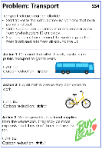
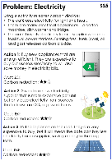
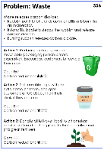
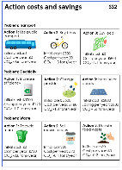
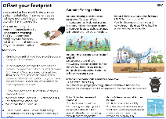
Help Coffee Club become carbon neutral
SS2
3. Write your recommendations
Here's what to include.
“We really care abut the planet and want to be carbon neutral, but we don’t want to spend too much money. So, we are hiring carbon consultants to recommend what to do.”
Introduction
What a carbon footprint is.
The café’s current carbon footprint.
What carbon neutral means.
Why it is important to be carbon neutral.
Middle
Actions
What actions you think the café should take.
The total initial and yearly costs.
Persuasive reasons to choose these actions (economic, social and environmental).
Offsetting
What carbon offsetting is.
What offsetting the café should use.
The yearly cost.
Persuasive reasons to choose this offsetting (economic, social and environmental).
Conclusion
Why this is the best plan for the café.
Why the owner should hire your team.
Rose – the café owner
You are a team of ‘carbon consultants’. You want to be chosen by the café to reduce their carbon footprint from 15 tons to 0. To do this, you will make your recommendations and present them to the owner.
Here is what to do: Resources to use:
1. How to reduce the footprint
There are three problems: transport, electricity and waste. Each has three possible actions.
Discuss the choices and choose one action for each problem.
Calculate total initial cost and yearly cost.
Add up how much CO₂ the actions will save.
Do your choices reduce the café’s carbon footprint to 0? If not, you need to change your choices.
SS4-6 from the ‘Choose actions’ activity
SS2: Action costs and savings
2. How to offset the footprint
Choose which carbon offsetting to use to get to carbon neutral.
Calculate the cost per year.
SS1: Offset your footprint

Slide 21
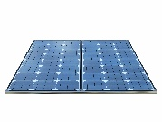
Action costs and savings
SS3
Action costs and savings
SS3
Problem: Transport
Problem: Transport
Action 1: Use public transport
Initial cost: £0
Cost per year: £0
CO₂: -0.6 tons/year
Action 2: Buy bikes
Initial cost: £500
Cost per year: £0
CO₂: -1.3 tons/year
Action 3: Buy local
Initial cost: £0
Cost per year: £600
CO₂: -1.1 tons/year
Action 1: Use public transport
Initial cost: £0
Cost per year: £0
CO₂: -0.6 tons/year
Action 2: Buy bikes
Initial cost: £500
Cost per year: £0
CO₂: -1.3 tons/year
Action 3: Buy local
Initial cost: £0
Cost per year: £600
CO₂: -1.1 tons/year
Problem: Electricity
Problem: Electricity
Action 1: Increase efficiency
Initial cost: £3000
Saving per year: £120
CO₂: -1.0 tons/year
Action 2: Change provider
Initial cost: £500
Cost per year: £180
CO₂: -1.4 tons/year
Action 3: Install solar
panels
Initial cost: £5000
Saving per year: £800
CO₂: -1.6 tons/year
Action 1: Increase efficiency
Initial cost: £3000
Saving per year: £120
CO₂: -1.0 tons/year
Action 2: Change provider
Initial cost: £500
Cost per year: £180
CO₂: -1.4 tons/year
Action 3: Install solar
panels
Initial cost: £5000
Saving per year: £800
CO₂: -1.6 tons/year
Problem: Waste
Problem: Waste
Action 1: Recycle more
Initial cost: £0
Cost per year: £720
CO₂: -0.8 tons/year
Action 2: Sell reusable cups
Initial cost: £0
Cost per year: £90
CO₂: -0.4 tons/year
Action 3: Donate food waste
Initial cost: £0
Cost per year: £0
CO₂: -0.2 tons/year
Action 1: Recycle more
Initial cost: £0
Cost per year: £720
CO₂: -0.8 tons/year
Action 2: Sell reusable cups
Initial cost: £0
Cost per year: £90
CO₂: -0.4 tons/year
Action 3: Donate food waste
Initial cost: £0
Cost per year: £0
CO₂: -0.2 tons/year
COFFEE
CLUB
COFFEE
CLUB

Slide 22
Assessment checklist
SS4
Award each ‘content’ item a mark out of 3, where 3 means it was fully covered.
Persuasive arguments should include a number of different economic, environmental and social consequences.
Section | Content | Group 1 | Group 2 | Group 3 | Group 4 | Group 5 | Group 6
Introduction | Carbon footprint explained
 | Carbon neutral explained
 | Explanation about why being carbon neutral is important
Actions | Three actions presented with costs
 | Achieves carbon neutral
 | Persuasive arguments about why to choose them
Offsetting | Offsetting explained
 | Recommendations given with cost per year
 | Persuasive arguments about why to choose them
Conclusion | Persuasive plea to choose their plan
Total for presentation
(mark out of 30)

