Slide 1
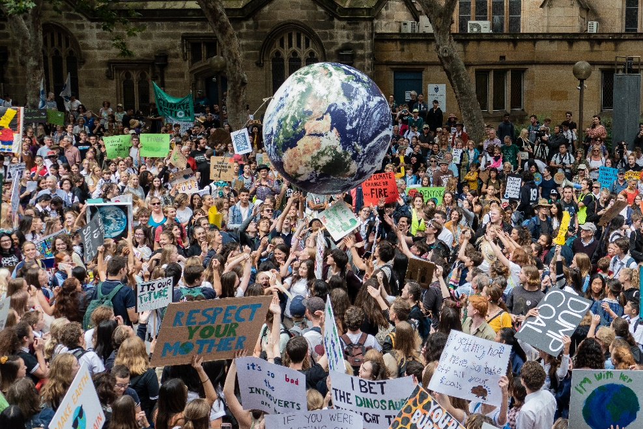
Carbon neutral
For Students

Slide 2
In compliance with

Slide 3
KNOW 2: Game

Slide 4
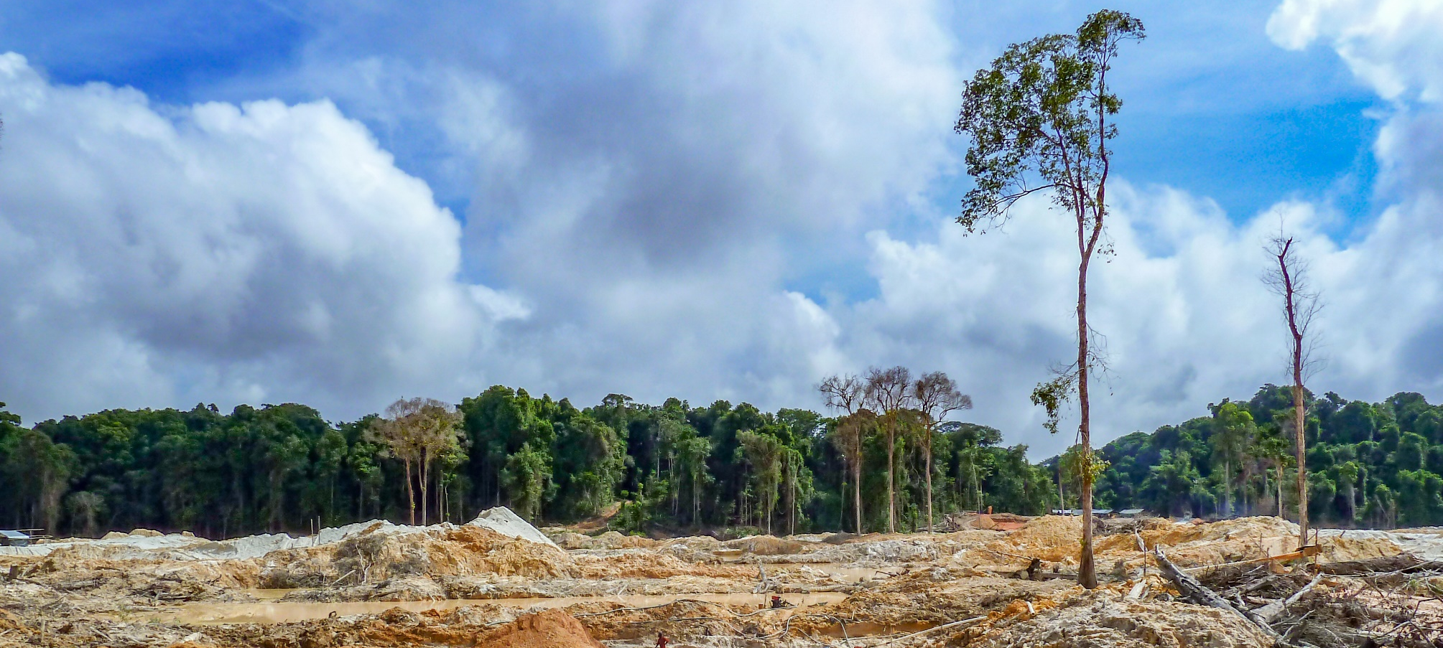
ENGAGE
World leaders promise to end deforestation by 2030
How will this help slow down climate change?

Slide 5
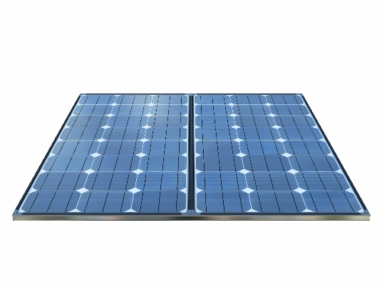
ENGAGE
I need your help to make my café carbon neutral. I’ve been researching different ways to reduce our CO₂ emissions.
But I can’t afford to do them all.
How can I decide which actions are best?

Slide 6
In this lesson, you will:
Learn how to make a scientific decision by examining the consequences of different actions

Slide 7
EXPLAIN
How can we decide which actions are best?
One way is to think of all the possible consequences.
Social
Economic
Environmental
How might people be affected?
How much money does it cost?
How might habitats be affected?

Slide 8
EXPLAIN
Consequences may be positive or negative.
To make a decision you weigh them up:
Negative consequences
Positive consequences

Slide 9
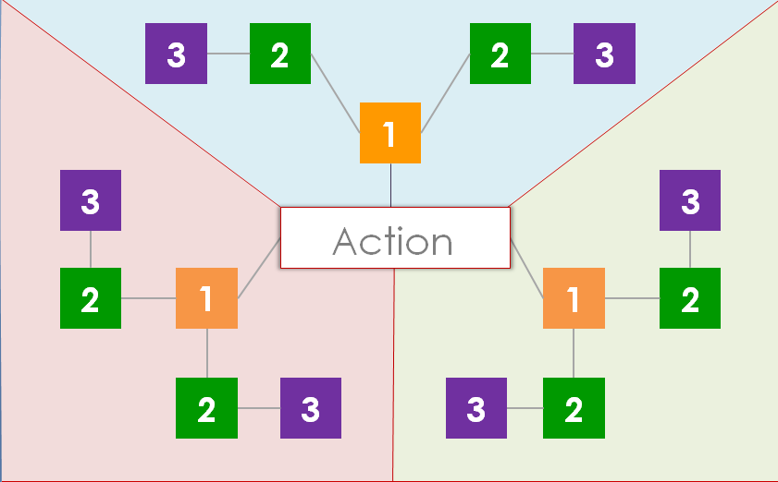
Practise making scientific decisions by playing the Consequences Game.
GUIDE
Should...
Activity: Consequences Game
Work in a group of 3.
Cut out the blank cards (SS1).
Read the rules (SS2).
Play the game on the board (SS3).
Decide if the action is a good idea.

Slide 10
EMPOWER
Please look at the actions to reduce my café’s CO₂ emissions and their consequences.
Remember, we only have a limited budget.
Activity: Examine the consequences SS4-6
Have each person in a group take one problem: transport (SS4), electricity (SS5) and waste (SS6).
Go through the consequences of each action.
Decide which one is best, with reasons.
Explain your choice to the group.

