Slide 1
Energy savers
For Students

Slide 2
In compliance with

Slide 3
The challenge

Slide 4
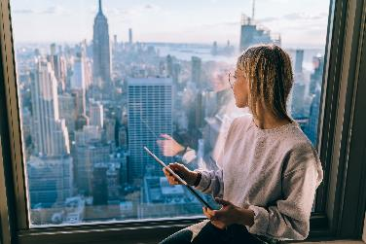
Imagine being able to travel from London to New York in an hour!
Wake in London
Go to work in New York

Slide 5
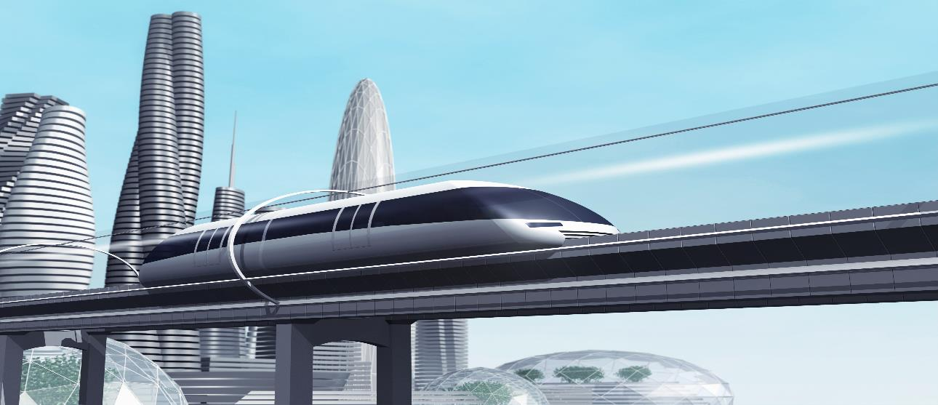
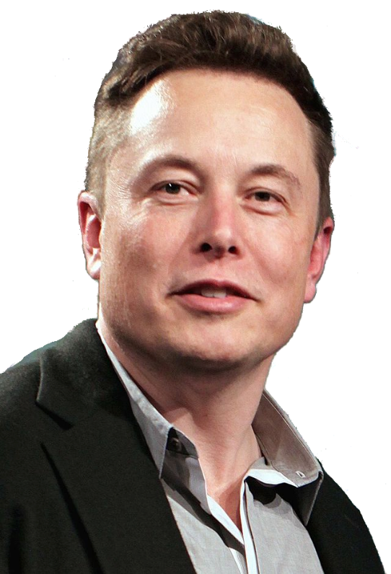
This is the my vision of an energy-saving train of the future - the ‘Hyperloop’.
It will whizz through an almost airless tube.
Elon Musk, entrepreneur
Why will the Hyperloop use less energy than a normal train?
Notes:
Image: Musk at the 2015 Tesla Motors Annual Meeting
https://www.flickr.com/photos/jurvetson/18659265152/
Author: Steve Jurvetson

Slide 6
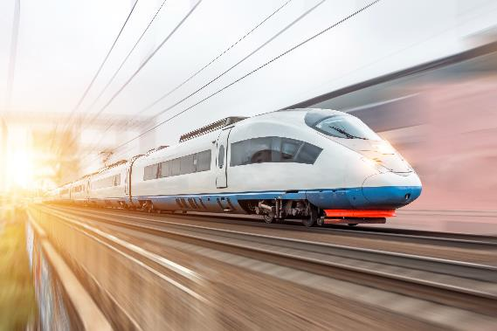
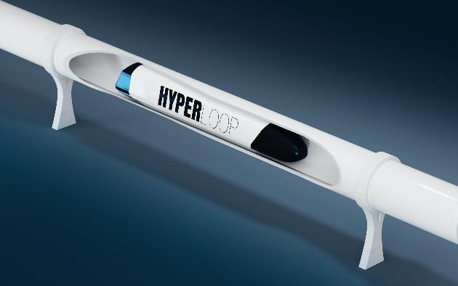
With normal trains, lots of energy is wasted.
Whereas the hyperloop will waste very little energy.
Friction with the air and track means energy is wasted as heat.
Low friction because the tube is almost airless and the train hovers over the track.

Slide 7
Your friend is an inventor.
I create energy saving inventions.
Not massive ones like the hyperloop but cheap devices that will help people save energy at home.

Slide 8
I have so many ideas but I’m not sure which is best.
Turbine Headband
Charge your phone while you run.
Washing pod
A potable washing machine
SunCook
Use the Sun’s energy to cook food
Can you help me choose one and get the funding to make it?

